Slide 1
PRACTICAL TEST 20.4.2022
2019 BATCH MBBS – B BATCH (114-150)
TOTAL MARKS - 25

Slide 2
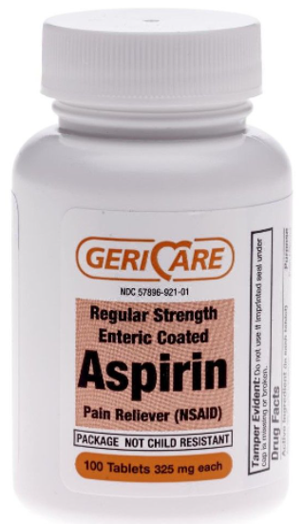
I.DRUG FORMULATION – 5 marks
ENTERIC COATED TABLET-ASPIRIN
1.Identify the given dosage form. Define tablets.
2.Enumerate different types of tablets.
3.What are the advantages of
enteric coated tablets? Give 2 examples

Slide 3
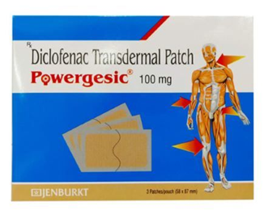
II.DRUG DELIVERY SYSTEM – 5 MARKS
1.Identify & describe the DDS
2.What are its advantages?
3.What are its disadvantages?

Slide 4
III.DRUG INTERACTIONS – 5 marks
A 30 year old female, known epileptic was well controlled with sodium valproate. She was prescribed Ciprofloxacin with paracetamol for enteric fever. After 4 days she developed seizures.
a) Comment on the possible drug interaction
b) Name 2 drugs that precipitate seizures in epileptics

Slide 5
IV.DOSAGE CALCULATION – 5 marks
1. A 35 year old man was admitted with history of diarrhoea & vomiting. On examination, he was found to be dehydrated. He needs 3 pints of Normal saline. Calculate the sodium chloride to be use.
(1 pint = 500ml),(Normal saline = 0.9 % sodium chloride solution).
2. Calculate the infusion rate of insulin in drops/minute for a patient weighing 70kg suffering from diabetic keto acidosis. Required therapeutic dose is 0.1 units/kg/hr. The given vial contains 40 units/ml. The drug should be delivered through 250ml of normal saline.

Slide 6
V.DRUG NOMENCLATURE – 5 Marks Answer for the given drug
Give the generic name & brand name of the drug
What is generic name of a drug
What is proprietary name of a drug
Which country has approved the drug
When does a drug approved by DCGI becomes official?
What are the advantages of using generic name?
What are the disadvantages of using generic name?

